Slide 1
Collaborative Software Development
Patricia Grubel (she/her) Los Alamos National Laboratory
Better Scientific Software tutorial @ Improving Scientific Software conference (2023)
Contributors: Patricia Grubel (LANL), David E. Bernholdt (ORNL), Rinku K. Gupta (ANL), Michael A. Heroux (SNL), Mark C. Miller (LLNL), Jared O’Neal (ANL), James M. Willenbring (SNL)
LA-UR-22-31408

Slide 2

License, Citation and Acknowledgements
License and Citation
This work is licensed under a Creative Commons Attribution 4.0 International License (CC BY 4.0).
The requested citation the overall tutorial is: David E. Bernholdt, Patricia A. Grubel, and David M. Rogers, Better Scientific Software tutorial, in Improving Scientific Software, Boulder, Colorado and online, 2023. DOI: 10.6084/m9.figshare.22179748.
Individual modules may be cited as Speaker, Module Title, in Tutorial Title, …
Acknowledgements
This work was supported by the U.S. Department of Energy Office of Science, Office of Advanced Scientific Computing Research (ASCR), and by the Exascale Computing Project (17-SC-20-SC), a collaborative effort of the U.S. Department of Energy Office of Science and the National Nuclear Security Administration.
This work was performed in part at the Argonne National Laboratory, which is managed by UChicago Argonne, LLC for the U.S. Department of Energy under Contract No. DE-AC02-06CH11357.
This work was performed in part at the Lawrence Livermore National Laboratory, which is managed by Lawrence Livermore National Security, LLC for the U.S. Department of Energy under Contract No. DE-AC52-07NA27344.
This work was performed in part at the Los Alamos National Laboratory, which is managed by Triad National Security, LLC for the U.S. Department of Energy under Contract No.89233218CNA000001
This work was performed in part at the Oak Ridge National Laboratory, which is managed by UT-Battelle, LLC for the U.S. Department of Energy under Contract No. DE-AC05-00OR22725.
This work was performed in part at Sandia National Laboratories. Sandia National Laboratories is a multi-mission laboratory managed and operated by National Technology and Engineering Solutions of Sandia, LLC., a wholly owned subsidiary of Honeywell International, Inc., for the U.S. Department of Energy’s National Nuclear Security Administration under contract DE-NA0003525.

Slide 3
Outline
Why Develop Software Collaboratively?
Tools
Version Control - Using Git
Git Workflows
Using Agile for Scientific Software
Kanban
Code Review
Software Licensing
Extra Slides – Git Workflows from CSE projects

Slide 4

Why Develop Software Collaboratively?

Slide 5
Why Develop Software Collaboratively?
Most real-world projects involve teams rather than individuals
Collaboration has advantages
Produces working code quicker
Better design from considering more points of view and experience
Can be more enjoyable, even a social experience
Collaboration has challenges
Logistics (time zones etc.)
Communication
Ensuring everyone is working from the same version and can contribute equally
Understanding other’s code and what they intended

Slide 6
Tools
agile
Kanban
feature branch
Git
lifetime branches
JIRA
code review
Git Workflows
Pull Requests
issue tracking
Scrum
policies
Trello
Github
version control
project boards
Gitlab
Notes:
All can access information provided by tools

Slide 7
Why do we need tools?
To keep organized when working on a team
Stay on the same page, same knowledge of the project, work, goals etc.
Keep track of, address and prioritize bug fixes, feature requests, etc.
Tools capture and mediate information about the collaborative process
A major tool used for version control is Git …
Notes:
All can access information provided by tools

Slide 8
Version Control – Using Git

Slide 9
Version Control - Git
Version control (or revision control) is a means of tracking changes made to source code
Various hosting services are available - GitHub, GitLab, Bitbucket, etc.
Main features of Git used for collaboration*
Branches - allows separate development for features or fixes on the same repo
Pull Requests (PRs) - Enables code review and testing before merge
Clones - allows each developer their own working copy
Forks - allows those outside the team to collaborate (open source software)
* This tutorial will cover the first two since knowledge of them is needed for the development workflow using Git, referred to as ”Git Workflow”

Slide 10
Version Control - Git
Allows collaboration while ensuring everyone works from the same version
Remote repo
Local repo for each developer

Slide 11
Use of Branches
Enables independent development for features or fixes on the same repo
Enables concurrent development by multiple developers
Provides different types of Workflows
Protects main branch
Develop on a branch, test on the branch, and merge into main
Integration occurs at merge commits
Notes:
Branches temporatily isolate different lines or portions of code development while maintaining the overall common context with other developers

Slide 12
Feature Branches
Organize a new feature as a sequence of related commits in a branch
main
main
main
main

Slide 13
How Do We Control Project Branch Complexity?
Workflow policy is needed
Project supported branches and workflows should not be unnecessarily complex
Individuals and sub-teams can leverage more complex models when advantageous
Descriptive names or names linked to issue tracking system
Where do branches start and end?
main
Notes:
Diverging commit histories cause problems.
Avoid these problems with policies
Polices are implemented and enforced by developers who can disscuss and change them as required

Slide 14
Infinite Lifetime Branches
Base off main branch
Exist in all copies of a repository
Each provides a distinct environment
Development, pre-production, release etc.
main

Slide 15
Branching Strategies
What’s stable, under what conditions?
What’s tested?
Branch Lifetimes
Indefinite - main, development, stable
Short term – feature, fixes
Longer Period – based on release schedules
Establish Workflow Policies
Notes:
Established Workflow policies help form a decision diagram that prevents thinking through how things should be done (Can be changed as needed though)

Slide 16
Pull Requests Why use Pull Requests?
Allows code review and testing before merge
Alerts team and others about changes in branch before merge
Discussions ensue with possible follow up commits
Can request reviewer (may want particular expertise, may want to give someone knowledge)
Set policies for merge
Enforce rules such as coding standards
Minimum number of reviewers
Protected branches – who can merge to certain branches etc.
Notes:
Maintainers may designate "code owners" who are responsible for reviewing contributions to specific portions of the codebase -- usually based on experience in that part of the code

Slide 17
What makes a good Pull Request?
Covers “one thing”
One body of work
Independently manageable
Avoid large PR’s - keep them small
Break them up if they get too large
Merge frequently (goes with keep them small)
Good description – helps reviewers and users

Slide 18
Git Workflows

Slide 19
What is a Git Workflow?
A Git workflow consists of the structure of the branches and policies
Designated lifetime branches
main, production, pre-production, development
Feature Branches
New features, bug fixes etc.
Schedules for releases (if applicable)
Testing
Branch Protections

Slide 20
Why use a Git Workflow?
Provides collaboration in a consistent and productive manner
Team members are on the same page for development
Policies make it clear
How to use the branching structure
What branches are protected
What is tested and when
What branches are stable
Helps team members understand the current state of the code

Slide 21
Commonly Known Git Workflows
Git Flow
GitHub Flow
GitLab Flow
Extra Slides at the end show real Git Workflows of some CSE projects
Design Patterns for Git Workflows by Roscoe A. Bartlett provides an extensive discussion of the concepts behind git workflows
Notes:
Going to cover this quickly, but want you to have the resources, there are also extra slides can help you see what might be useful for your Scientific projects
May want to add when and why to use them

Slide 22
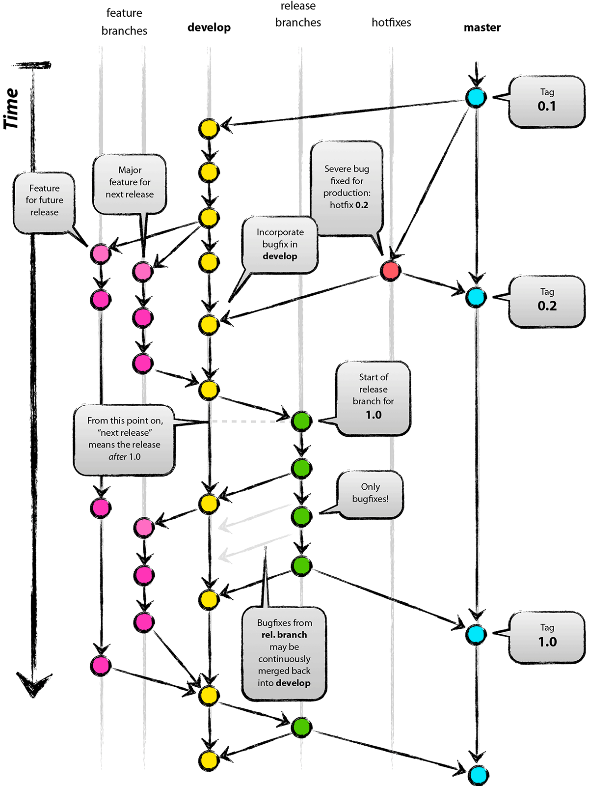

Git Flow
Full-featured workflow
Increased complexity
Designed for Software with official releases
Feature branches based off of develop
Git extensions to enforce policy
How are develop and main synchronized?
Where do merge conflicts occur and how are they resolved?
main
Author: Vincent Driessen
Original Blog: https://nvie.com/posts/a-successful-git-branching-model/
License: Creative Commons
Notes:
Go through quickly shows complexity and designed for SW with official releases add why use this

Slide 23
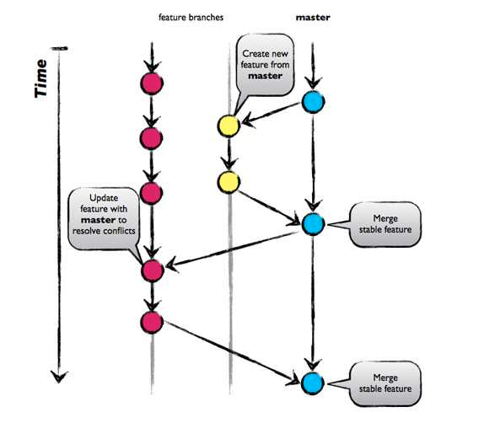
GitHub Flow
http://scottchacon.com/2011/08/31/github-flow.html
Published as viable alternative to Git Flow
No structured release schedule
Continuous deployment & continuous integration
Simpler workflow
Key Ideas
All commits in the main branch are deployable
Base feature branches off main
Push local repository to remote constantly
Open Pull Requests early to start dialogue
Merge into main after Pull Request review
Notes:
Go through quickly – point out No structured release schedule, continuous integration, simpler add why use this

Slide 24
GitLab Flow
https://docs.gitlab.com/ee/topics/gitlab_flow.html
Published as viable alternative to Git Flow & GitHub Flow
Semi-structured release schedule
Simplifies difficulties in synchronizing infinite lifetime branches
Key Ideas
Main branch is staging area
Mature code in main flows downstream into
pre-production & production infinite lifetime branches
Allow for release branches with downstream flow
Fixes made upstream & merged into main.
Fixes cherry picked into release branch
main
pre-production
production
feature
deploy
deploy
deploy
deploy
Notes:
Go through quickly Use this if the release schedule is not as structured

Slide 25
Guidelines for establishing a Git Workflow
Communicating it to your collaborators
Include workflow in Contributing Guide
Establish conventions for branch naming (issues, major/minor versions)
Enforce workflow
Branch protections
Limiting who can push/merge
Testing & review requirements
Adopt what is good for your team
Consider team culture and project challenges
Assess what is and isn’t feasible/acceptable
Start with simplest and add complexity where and when necessary
Notes:
Emphasis on Adopt what is good for your team

Slide 26
Using Agile for Scientific Software
Notes:
Heavy weight approaches do not usually fit the scientific domain well. For a small team using agile the team can choose the processes that will help the particular team.

Slide 27
Why Agile?
Fits the research experience better than heavier-weight approaches
Aligns more naturally with how scientific progress is made
Well-suited for scientific software efforts (when tailored correctly)
Works well for small teams
Provides meaningful, beneficial structure that promotes
Productivity
Productization
Sustainability
Flexibility in requirements
Communication
Notes:
Heavy weight approaches do not usually fit the scientific domain well. For a small team using agile the team can choose the processes that will help the particular team.

Slide 28
What is Agile?
Agile is not a software development lifecycle model
Some “common misconceptions” about agile
I don’t write documentation
I don’t do formal requirements, design, or really test…
Agile is not an excuse to do sloppy work
Some people consider agile to be synonymous with Scrum
From Atlassian: Scrum is a framework that helps teams work together
Scrum is Agile, Agile is not (only) Scrum
A square is a rectangle, not all rectangles are squares
Agile is not Kanban either
Notes:
Scrum is widely used in the enterprise communities. Scrum in scientific teams has not been explored much.

Slide 29
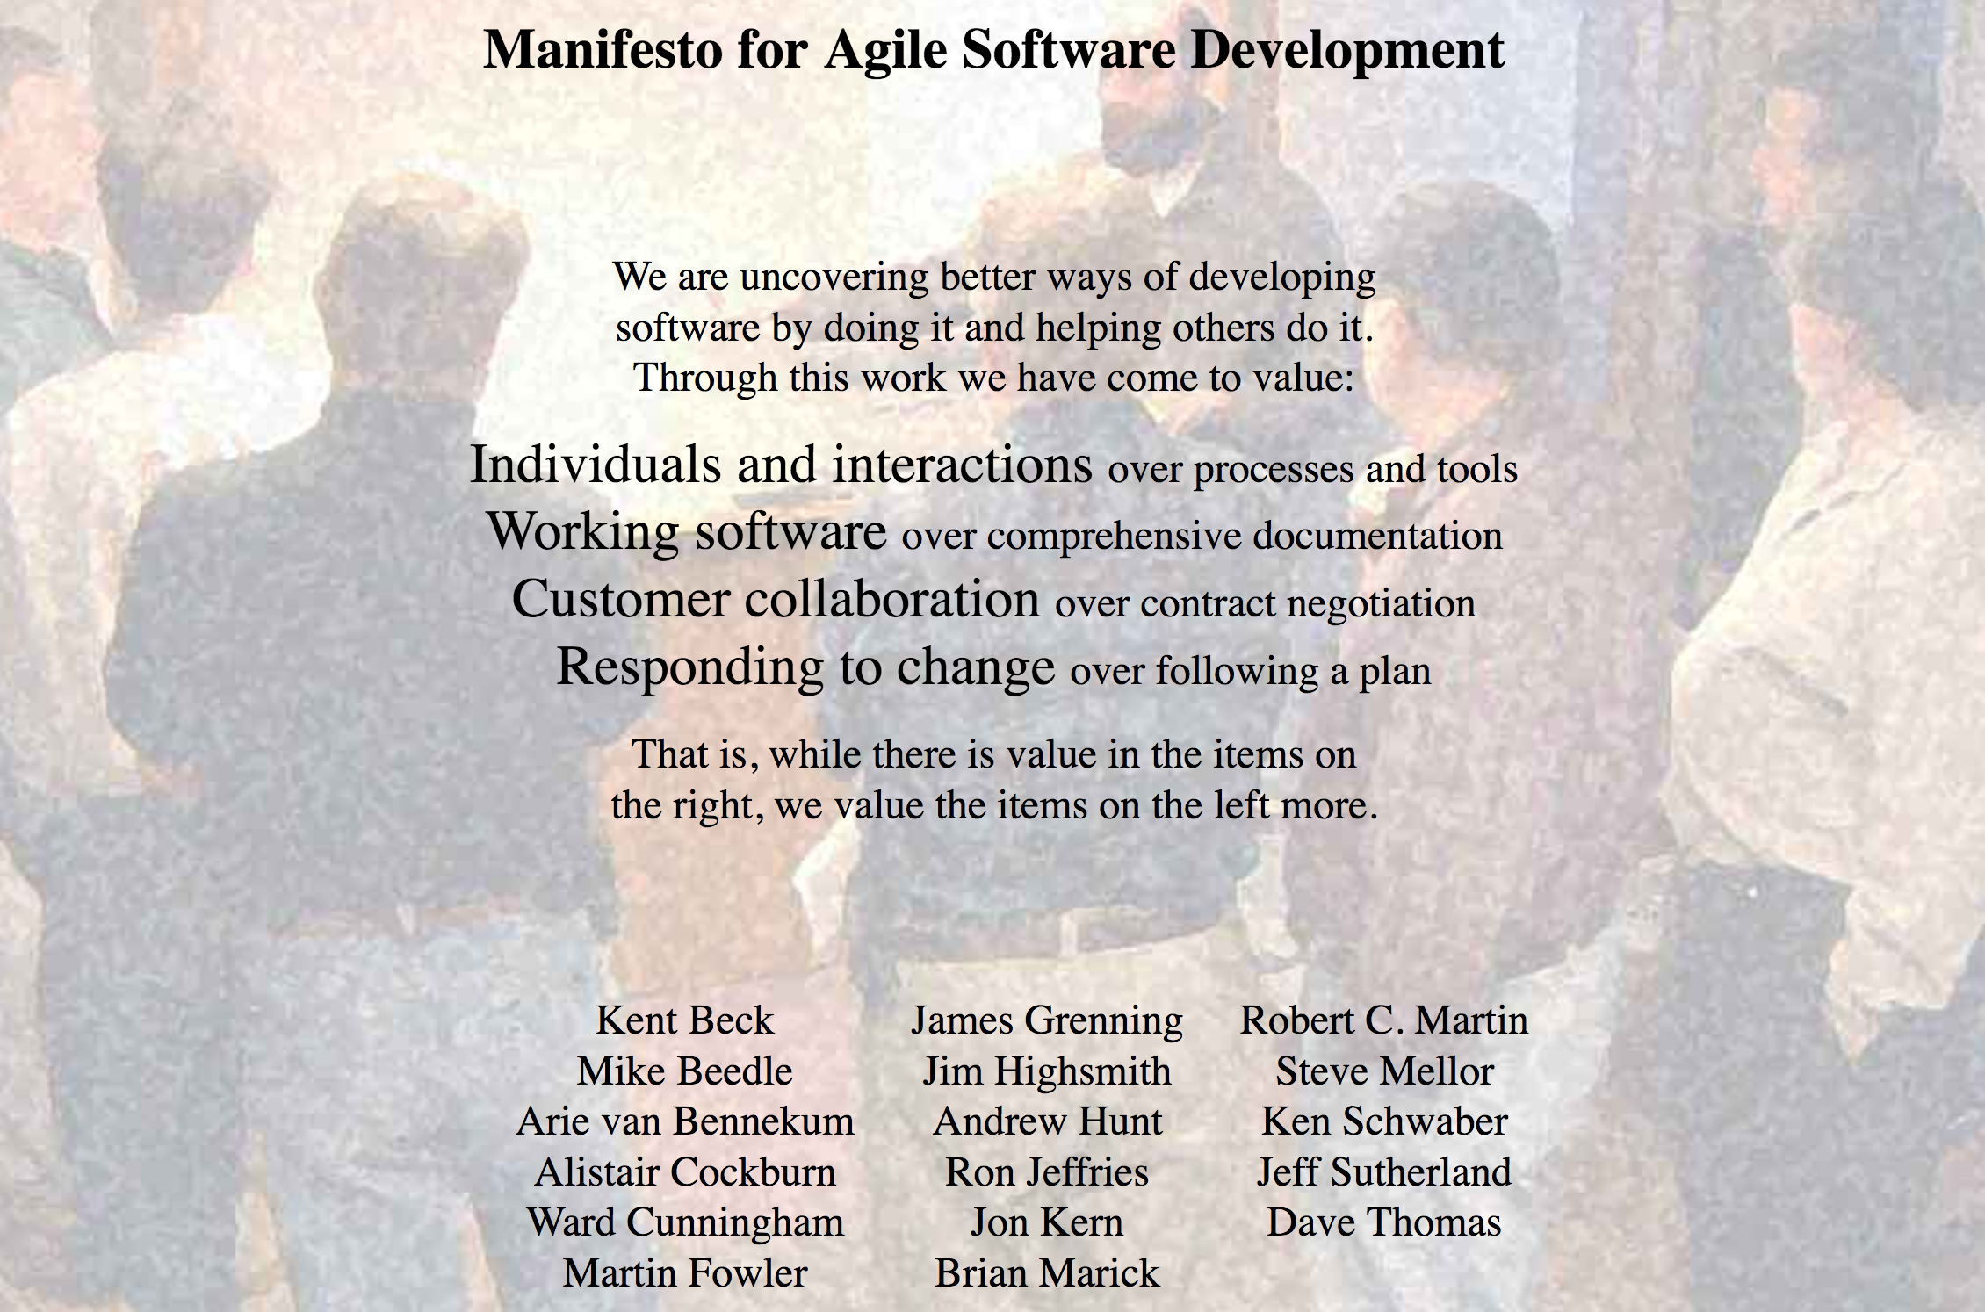
What is Agile?
http://agilemanifesto.org/
Notes:
4 critical components above the red box. The left hand side is emphasized over the right such as Working Software. Although comprehensive documentation is important, Working Software would take precendence. Look over the manifesto and the four main components.

Slide 30
Getting Started with Agile
Agile principles are not hard and fast rules
Try adopting a few Agile practices
Following a rigid, ill-fit framework usually leads to failure
Kanban is a good starting framework
Follow basic principles
Add practices when advantageous
Better than removing elements from Scrum
Task: Have Eureka moment by Tuesday.
Scrum
Notes:
Pick a practice to try and if it works for your team add it to your processes. Easier to get started with Kanban and add practices
Add practices when needed such as for more rigor/process to keep things under control

Slide 31
Kanban
Notes:
Pick a practice to try and if it works for your team add it to your processes. Easier to get started with Kanban and add practices
Add practices when needed such as for more rigor/process to keep things under control

Slide 32
Basic Kanban
Backlog | Ready | In Progress | Done
Any task idea Trim occasionally Source for other columns | Task + description of how to do it. Could be pulled when slot opens. Typically comes from backlog. | Task you are working on right now. The only Kanban rule: Can have only so many “In Progress” tasks. Limit is based on experience, calibration. Key: Work is pulled. You are in charge! | Completed tasks. Record of your life activities. Rate of completion is your “velocity”.
Notes:
Ready column is not strictly required, sometimes called “Selected for development”.
Other common column: In Review
Can be creative with columns:
Waiting on Advisor Confirmation
Under review
Blocked
Notes:
You may have other columns In Review etc. you can be as creative as you want. Design it how it works for you.

Slide 33
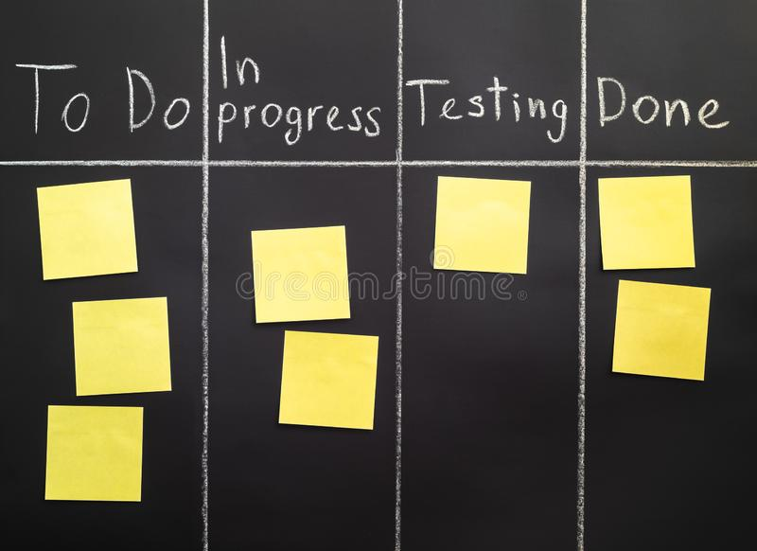
Kanban principles
Limit number of “In Progress” tasks
Must be tuned by each team
Common convention: 2n-1 tasks where n = # team members
Productivity improvement:
Optimize “flexibility vs swap overhead” balance. No overcommitting.
Productivity weakness exposed as bottleneck. Team must identify and fix the bottleneck.
Effective in R&D setting. Avoids a deadline-based approach. Deadlines are dealt with in a different way.
Provides a board for viewing and managing issues
Notes:
Consider the cost of context switching, Kanban is good at exposing bottlenecks, If you have a column like “Waiting for Review or Blocked” that is full you can easily see the bottleneck.
Kanban also naturally supports researcher/developers who might be part-time on multiple projects (scrum tends to assume people are full time on one project)

Slide 34
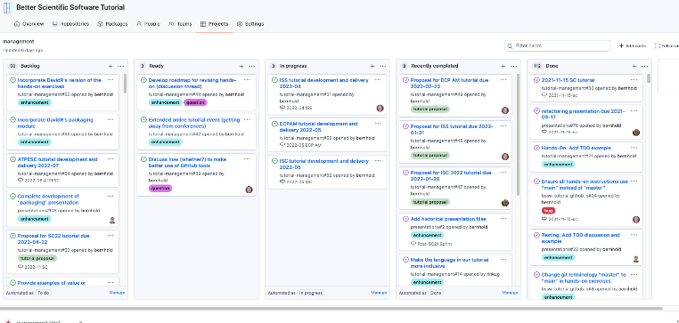
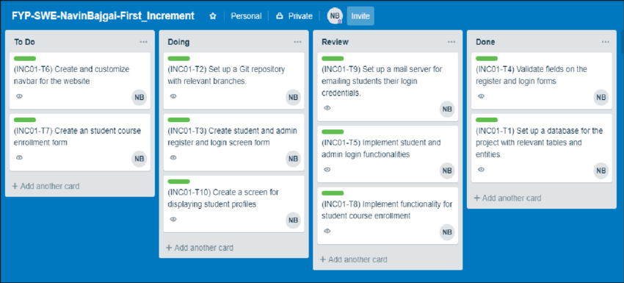
Kanban tools
Wall, whiteboard, blackboard: Basic approach.
Software, cloud-based:
Trello, JIRA, GitHub or GitLab Issues & Project Boards
Many more.
Trello (browser, Android, iPhone, iPad).
Can add, view, update, anytime, anywhere.
Different boards for different contexts
Effective when people are split on multiple projects

Slide 35
Big question: How many “active” tasks?
No single answer. Choose something and adjust from there.
Personal Kanban approach: Start with 2 or 3.
Use a freeway traffic analogy:
Does traffic flow best when fully packed? No.
Same thing with your effectiveness.
Spend time consulting board regularly.
Brings focus.
Enables reflection, retrospection.
Use slack time effectively.
When you get out of the habit, start up again.
Steers towards previously started tasks
Notes:
Highlight very quickly

Slide 36
Code Review
Notes:
Transition – How does code review fit into this process?

Slide 37
Code Review – What Peer Code Review Can Provide
Allows discussion of proposed changes
Iterations for better code
Discussions and reviewing allow more understanding of the code
Ensures requested change/feature met
Evaluates impact of the change
Breakages
Interactions with other parts of code
Ensures coding guidelines are met
Improves practices by learning
About other parts of the code
Helpful coding techniques by others
Blog: How to code review in a Pull Request
Author: Hugo Sousa - March 17, 2021
https://blog.codacy.com/how-to-code-review-in-a-pull-request/
Notes:
Transition – How does code review fit into this process?

Slide 38
Code Review - Improvement and Practices
Helpful practices for scientific research software
Make code review process formal with structured guidelines
Allocate sufficient time in the development process to perform code review
Try to ensure at least one science review and one technical review
Timely reviews - provide quick feedback to incoming review requests
Train reviewers on how to phrase good feedback
Train developers to accept comments to improve their code
Include automatic code review tool and train reviewers in best use practice of the tool
Investing in Code Reviews for Better Research Software (2022-10-12)
Presenters : Thibault Lestang, Dominik Krzemiński and Valerio Maggio
https://ideas-productivity.org/events/hpc-best-practices-webinars/#webinar068
Testing and Code Review Practices in Research Software Development (2020-09-09)
Presenter: Nasir Eisty
https://ideas-productivity.org/events/hpc-best-practices-webinars/#webinar044

Slide 39
Software Licensing

Slide 40
Software Licensing
Any software you write is “born copyrighted”
Copyright holder is usually you (as author) or your employer (more likely)
By default, that copyright is “all rights reserved” to the holder of the copyright
Specifying a license controls how others can use or contribute to the software
Treat the license as a tool to help you accomplish your goals for the software
Potentially many considerations in choosing a license
For open source licenses
Choose an Open Source Initiative approved license (don’t make up your own)
Try a tool like https://choosealicense.com/
Make sure your chosen license is clearly expressed in your code repository
For considerably more information see: Introduction to Software Licensing from Best Practices for HPC Software Developers webinar series

Slide 41
Extra Slides – Git Workflows from CSE projects
Notes:
"If you want to look at detailed cases from actual projects, these extra slides are included."

Slide 42
Current Trilinos Workflow
https://trilinos.github.io/
Test-driven workflow
Feature branches start and end with develop
All changes to develop must come from GitHub pull requests
Feature branches are merged into develop only after passing pull request test suite
Change sets from develop are tested daily for integration into main
Workflow designed so that
All commits in main are in develop
Merge conflicts exposed when integrating into develop
Merge conflicts never occur when promoting to main
main
develop
develop -> main testing
Pull request testing
Issue 1
Issue 2
Notes:
From the website: The Trilinos Project is a community of developers, users and user-developers focused on collaborative creation of algorithms and enabling technologies within an object-oriented software framework for the solution of large-scale, complex multi-physics engineering and scientific problems on new and emerging high-performance computing (HPC) architectures.
Trilinos is also a collection of reusable scientific software libraries, known in particular for linear solvers, non-linear solvers, transient solvers, optimization solvers, and uncertainty quantification (UQ) solvers.

Slide 43
Current Open MPI Workflow
Workflow designed so that
Support two most recent releases
Issues are addressed on all applicable branches
All PR’s reviewed by at least one core developer
Main and supported branches work at all times
Developers work on main or feature branches depending on complexity of the changes
Testing
CI testing on PR’s for any branch using Jenkins (limited set of compilers, hardware, tests)
Nightly testing on all branches using community-built MTT framework (more complex set of compilers, hardware, tests)
Additional testing for release candidates
https://www.open-mpi.org
Versioning:
Major versions - break compatibility
Minor versions – visible
Releases correct issues
main
Upcoming release (if exists)
Latest supported release
Previous supported release
Issue 1
Issue 2
Notes:
A High Performance Message Passing Library

Slide 44
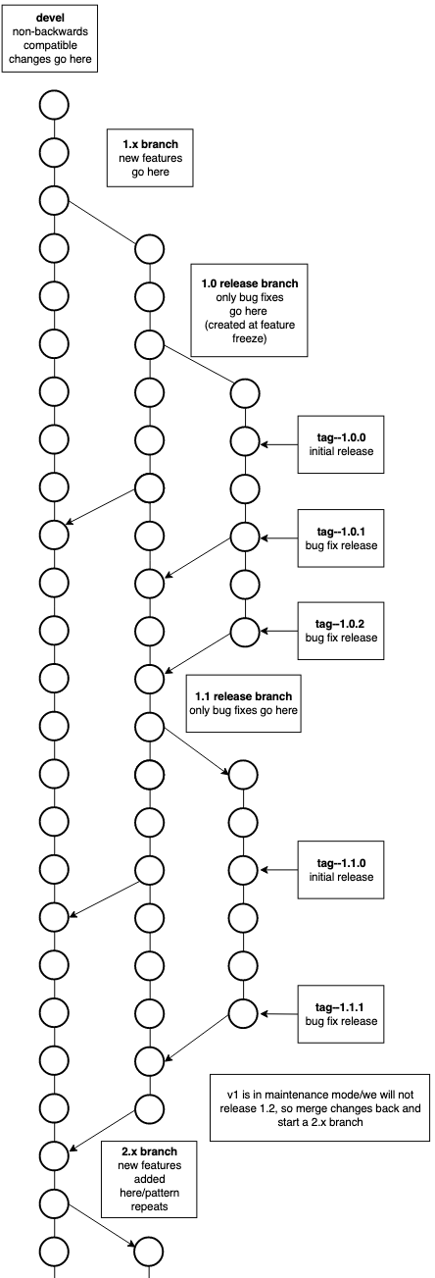
Current FleCSI Workflow
https://flecsi.github.io/flecsi
Versioning:
Incompatible - devel branch breaks compatibility with previous versions
Feature (1, 2 …) named for major version
Release - (1.x, 2.x …) named for major.minor version, correct issues, tags used for bug fixes.
Workflow designed so that
All supported branches work at all times
Merge Requests are tested and reviewed
Testing
Customized unit-testing framework based on Google Test
Special gitlab-ci branch - images and configuration files
Notes:
FleCSI is a compile-time configurable framework designed to support multi-physics application development for current and emerging HPC systems.
In the diagram there is a 1.x branch only for new releases, an initial 1.0 release branch with tag 1.0.0 as the initial release and tags 1.0.1, 1.0.2 for bug fixes, when 1.1 feature is release again an initial tag 1.1.0, then bug fix release tags 1.1.1 & 1.1.2 etc. Once a major version goes into maintenance mode and a new major feature branch begins; in this case 2.x and like branches and tags are created for 2.x

